Slide 1


WAGCG TECHNICAL SESSION · 19 June 2026
Pretty Pictures
or Better Decisions?
Elastic modelling, the Kirsch equation, and correlating stress with ground support requirements
Frans Basson · BasRock
WAGCG 19 June 2026
Notes:
0:00–0:30 (≈30 min total, incl. ~5 min Q&A). Welcome. The title is the question that runs through the whole talk: our 3D stress models are beautiful — but does the picture actually change a decision? Roadmap: (1) the one equation behind every stress-based support criterion, (2) how boundary-element modelling lets us read the field anywhere, (3) a recorded GEM4D + BasRock.BEM demonstration, (4) the conclusion plus a live interactive tool.

Slide 2
Discussion points
This talk will follow one equation — from a hole in a plate to correlating the tangential stress with ground support requirements.
Kirsch Equation history
10 min
1
Elastic modelling
4 min
2
Demonstration: GEM4D BEM
10 min
3
Conclusions
3 min
4
BasRock
Notes:
0:30–1:00. Set up the spine of the talk in three sentences, then walk the agenda. Flag that Section 3 is a recorded GEM4D demo and that we finish on a live interactive tool. Keep this brief — the content does the work.

Slide 3
SECTION 01
01
Kirsch Equation history
10 minutes
One equation underlies nearly every stress-based support criterion
Notes:
1:00. Section 1 (8 min). Goal: by the end, everyone shares the same mental model of the Kirsch equation, in-plane stress, the far/near-field split, and what a minode is.

Slide 4

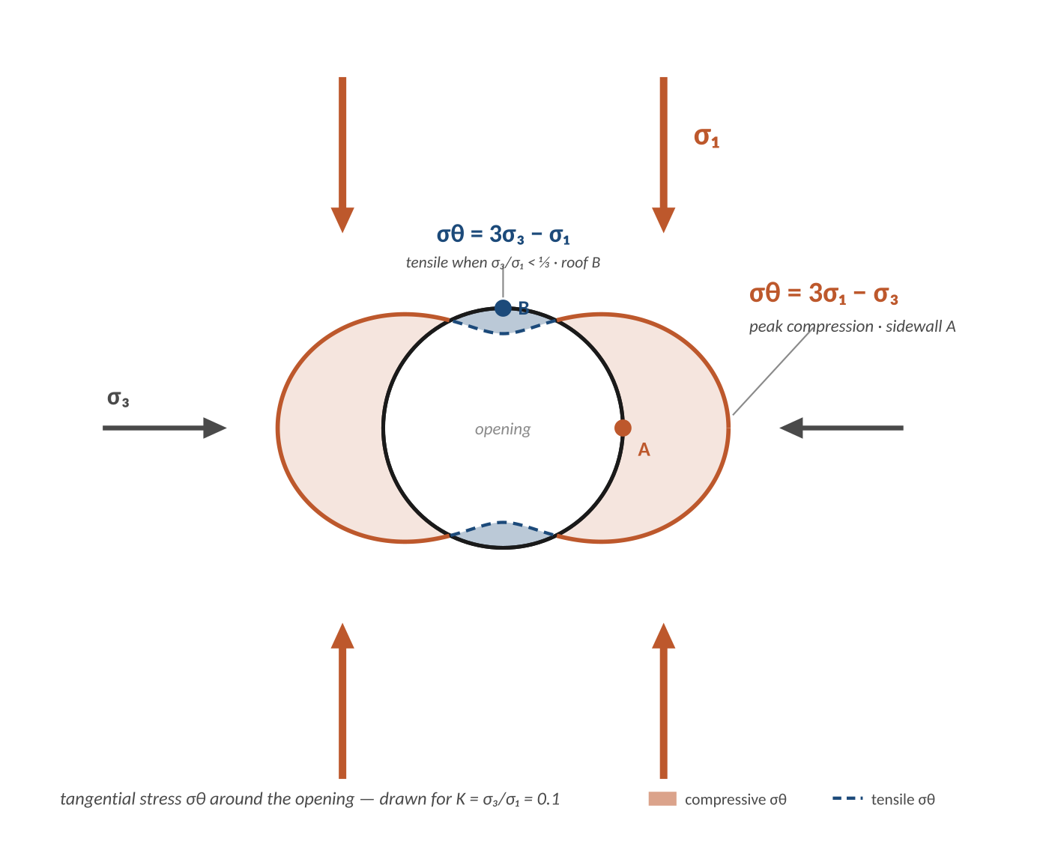
01 · BACKGROUND
Kirsch, 1898 — a hole in a plate
Kirsch solved the stresses around a circular hole in a loaded plate — drawn for rivet holes in steel, not tunnels. A century later, it is still used in geotechnical engineering.
σ_{1ip} = σ_{H} = σ_{max}
SIDEWALL A · THE WORKHORSE
σ_{θ} = 3σ₁ − σ₃
σ_{3ip} = σ_{h} = σ_{min}
Peak tangential stress — the number nearly every criterion divides.
ROOF & FLOOR B
σ_{θ} = 3σ₃ − σ₁
Goes tensile when σ₃ / σ₁ < ⅓.
Kirsch, 1898
BasRock
Notes:
1:10–3:00. The origin point. Kirsch was solving for rivet holes in steel plate — the circular-hole solution. Walk the diagram: σ₁ squeezes vertically, σ₃ horizontally; the rust lobes show tangential stress σθ peaking at the sidewall (point A, 3σ₁−σ₃) — the workhorse number; the small blue caps at roof and floor (point B) go tensile when σ₃/σ₁ < ⅓. Everything later in the talk reuses this numerator.

Slide 5
01 · BACKGROUND
Typical Australian mine environment
Typical South African gold mine environment
Kirsch, 1898
BasRock
Notes:
1:10–3:00. The origin point. Kirsch was solving for rivet holes in steel plate — the circular-hole solution. Key takeaways: σθ peaks at the sidewall (3σ₁−σ₃) — this is the workhorse number; roof/floor (3σ₃−σ₁) can go tensile. Everything later in the talk reuses this numerator.

Slide 6

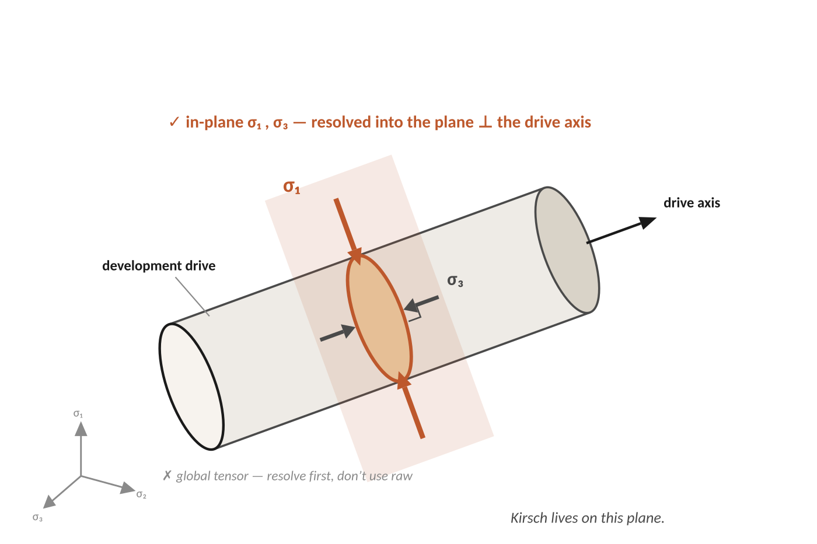
01 · BACKGROUND
Use the in-plane stresses — not the global tensor
Kirsch is two-dimensional — it is calculated in the plane perpendicular to the drive axis.
Feed it the principal stresses resolved on that plane, not the raw global σ₁ & σ₃ values.
The tangential stress thus changes with the drive orientation:
  Highest when perpendicular to σ₁.
  Lowest when parallel to σ₁.
σ_{1ip} = σ_{H} = σ_{max}
σ_{3ip} = σ_{h} = σ_{min}
The most common mistake when using RCF for stress-based design:
Global σ₁ & σ₃ → wrong stresses → wrong σ_{θ} → wrong RCF → wrong bolt
BasRock
Notes:
3:00–4:30. The single most common practical error. Point at the diagram: the orange section is the plane perpendicular to the drive axis — Kirsch lives on that plane. Resolve the tensor into it and use those in-plane σ₁, σ₃; the faint global triad bottom-left is what you must NOT feed in raw. Turn the drive and the plane turns with it — same rock, different σθ.

Slide 7

01 · BACKGROUND
Kirsch equation history in geotechnical engineering
1979
Wiseman
SCF · threshold ≈ 0.8
1987
Ryder
F-factor → RCF
1898
Kirsch
stress around a hole
1980
Hoek & Brown
rock strength m, s
1999
Martin et al.
m = 0, s = 0.11 · depth of failure
1979 · Wiseman – SCF
Sidewall Stress Concentration Factor
1987 · Ryder – RCF
Rockwall condition Factor
1999 · Martin, Kaiser, McCreath - Di
Damage Index
( 3σ₁ − σ₃ ) / σ_{c}
( 3σ₁ − σ₃ ) / ( F · σ_{c} )
( 3σ₁ − σ₃ ) / σ_{c} · fails ≈ 0.4
One numerator. Two denominators.
Wiseman, 1979 · Hoek & Brown, 1980 · Ryder, 1987 · Martin, Kaiser & McCreath, 1999
BasRock
Notes:
4:30–6:00. The memorable spine. Walk the timeline: Kirsch (boundary stress) → Wiseman 1979 (stress concentration factor, ~20 km of gold tunnels, threshold ≈0.8) → Hoek & Brown 1980 (strength via m,s) → Ryder 1987 (F-factor downgrade → Rock Condition Factor) → Martin et al. 1999 (brittle m=0, s=0.11, depth of failure). Then point at the chips: the numerator 3σ₁−σ₃ never changes — only what divides it. Refrain: same numerator, new denominator each time.

Slide 8
1979
Wiseman
Wiseman turns Kirsch into a design number.
Norman Wiseman, at the South African Chamber of Mines Research Organisation (COMRO), logged conditions of more than 20 km of gold mine tunnels in the late 1970s.
COMRO South Africa
20 km of tunnels
SCF criterion
Tunnel conditions correlated cleanly with one ratio: the Kirsch maximum tangential stress, divided by intact rock strength. He called it the Sidewall Stress Concentration Factor.
THE WISEMAN CRITERION
THRESHOLD
3σ₁ − σ₃
SCF > 0.8
σc
Conditions in unsupported tunnels deteriorated rapidly.
SCF · Sidewall Stress Concentration Factor
20 km of tunnel · one number · empirical threshold

Slide 9
1980
Hoek & Brown
Meanwhile, on the strength side of the equation…
In the same window of years, Evert Hoek and Ted Brown tackled the other half of the problem: how strong is the rock mass, really?
Strength criterion
m, s parameters
Rock-mass quality
THE STRESS STRAND
THE STRENGTH STRAND
Wiseman · 1979
Hoek & Brown · 1980
Kirsch · 3.σ₁ − σ₃
σ₁ = σ₃ + √(m.σ₃.σ_{c} + s.σ_{c}²)
Quantify the demand on the rock from in-situ stress and excavation shape. Compare to a fixed strength.
Quantify the rock-mass strength itself, from intact UCS and a classification-derived quality measure.

Slide 10
1987
Ryder
Ryder adds the F — the Rockwall Condition Factor.
John Ryder, also at COMRO, took Wiseman's equation and divided the denominator by a downgrading factor F. F captures the strength reduction from joints, weathering, alteration — everything Wiseman's intact UCS missed.
Add F factor
Downgrade UCS
RCF is born
RCF
F from rockmass class
3σ₁ − σ₃
Condition | F
Massive, unjointed | 1.0
Slightly jointed | 0.8 – 0.9
Moderately jointed | 0.65 – 0.8
Jointed | 0.55 – 0.65
Intensely jointed | 0.5
F · σ_{c}
Rockwall Condition Factor
Codified in COMRO 1988 and the Jager & Ryder Handbook 1999.

Slide 11
1999
Jager & Ryder
Handbook
RCF thresholds — the industry-accepted bands.
Calibrated against tens of kilometres of South African gold mine tunnels. Confirmed to apply well outside that context.
Industry bands
Calibrated globally
Still in use today
< 0.7
Stable, minor stress damage
Nominal pattern bolting
0.7 – 1.0
Moderate stress damage; minor spalling
Pattern bolts + mesh
1.0 – 1.4
Severe spalling, significant slabbing
Pattern bolts + mesh + shotcrete; cables
1.4 – 2.1
Heavy damage; rockburst-prone
Yielding support, cables, fibre-shotcrete
> 2.1
Extreme; stability difficult to achieve
Avoid; destress + dynamic support

Slide 12
1999
Martin, Kaiser
& McCreath
The Canadian pivot — cohesion loss, m = 0, s = 0.11.
Same Kirsch numerator. Different strength side.
Martin, Kaiser and McCreath reviewed case histories where brittle failure had been mapped around tunnels — from massive granite to weak sedimentary rock. They found the failure initiates at a remarkably constant value, regardless of rock type:
Canadian pivot
Brittle parameters
Depth of failure
Damage Index => Di
Di = σ_{max} / σ_{c} ≅ 3σ₁ − σ₃ / σ_{c}
THE TRICK FOR BRITTLE FAILURE
m = 0 | s = 0.11
damage initiates at 40 % of intact UCS
AND THE KEY OUTPUT — THE DEPTH OF FAILURE
Rf / a = 0.49 (±0.1) + 1.25 · σ_{max} / σ_{c}
Because in brittle rock, peak cohesion and peak friction are NOT mobilised together — cohesion loss drives the failure.
Martin, Kaiser & McCreath, 1999

Slide 13

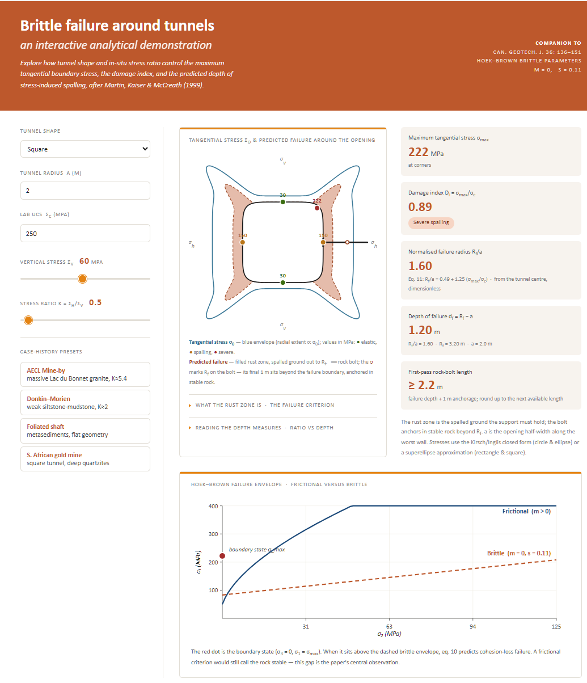
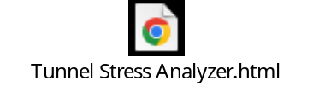
04 · CONCLUSION & TOOL
See it move — the brittle-failure tool
https://basrock.co/pptx/Tunnel%20Stress%20Analyzer.html
Watch the red dot: above the brittle line but below the frictional one — failure that a frictional criterion calls “stable”. That gap is the whole point.
after Martin, Kaiser & McCreath, 1999
BasRock
Notes:
21:00–23:30 (≈2 min video). >>> EMBED THE INTERACTIVE-TOOL VIDEO over the left frame (Insert ▸ Video ▸ This Device). Talking point: as K changes, watch the red point sit above the brittle envelope (m=0, s=0.11) yet below the frictional one — a frictional criterion would call that ground stable. Tie back to depth of failure → bolt length.

Slide 14
Two paths,
same Kirsch
RCF vs the Martin/Kaiser damage index
Rock Condition Factor
Damage Index
 | RCF | Di
Equation | (3σ₁ − σ₃) / (F · σ_{c}) | (3σ₁ − σ₃) / σ_{c}
Strength side | Rock-mass strength via F | Intact UCS direct
Damage threshold | ≈ 0.7 | ≈ 0.4
Best for | Condition, sequencing, planning | Bolt length, support demand
Output | A condition class | Depth of failure Rf / a
Use in model | Far-field (no explicit removal) | Far-field + near-field m=0,s=0.11
Same numerator
Different denominator
Different purpose
In practice, use BOTH — RCF for the planning questions, Di for the support questions.

Slide 15

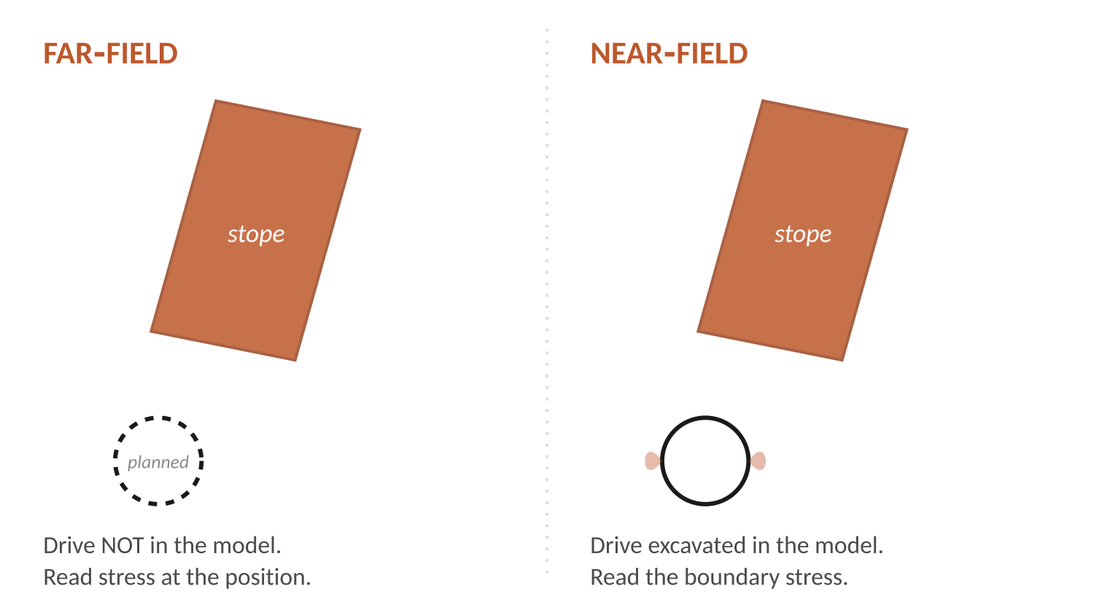
01 · BACKGROUND
Far-field vs near-field — two different questions
FAR-FIELD · where should the drive go?
Assess the stress at the position before the drive is excavated — the drive isn’t in the model. Fast; many positions from one solve. Contour to find the best location. → RCF, σ₁.
NEAR-FIELD · what are the boundary stresses?
Explicitly excavate the drive and read the stress on its boundary. → extension strain; depth of brittle failure (m = 0).
Don’t use RCF for near-field — the Kirsch concentration is already baked in. You’d be counting it twice.
Barsanti & Basson, 2015
BasRock
Notes:
6:00–7:40. The distinction people most often miss. Far-field: read stress at a point with the drive NOT excavated — quick, lets you contour many candidate positions; this is RCF / σ₁ territory for planning. Near-field: actually cut the drive and read the boundary stress — extension strain and depth-of-failure. Punchline: RCF already contains the Kirsch concentration, so using it near-field double-counts.

Slide 16

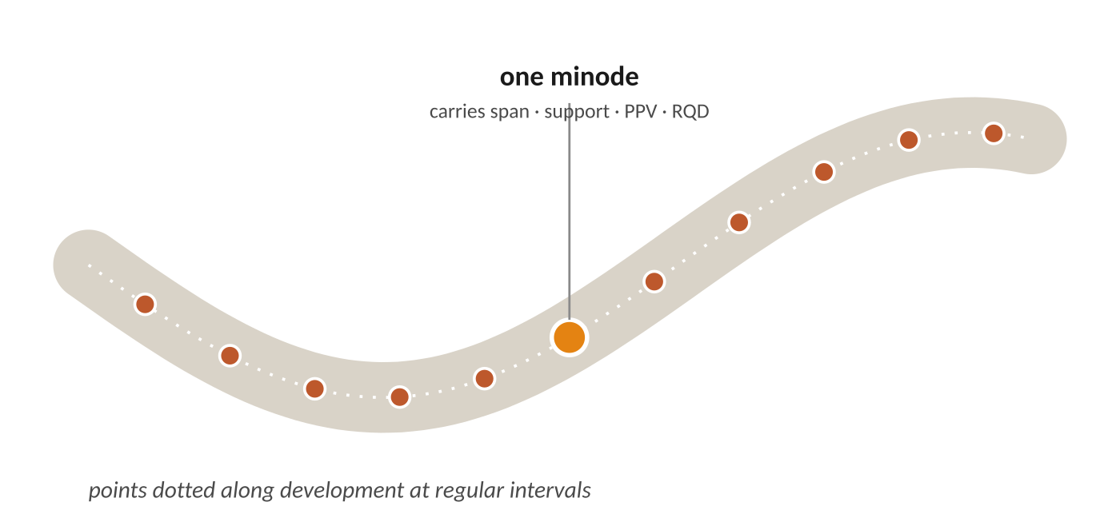
01 · BACKGROUND
Minodes — carrying the model back to the drive
Points dotted along the development at regular intervals.
Each one carries span, support, PPV hazard and RQD.
They bridge a model result to the real excavation geometry — sample along the drive and compare directly with mapped conditions.
Basson · mXrap / GEM4D
BasRock
Notes:
7:40–9:00 (end of Section 1). A minode is a sampling point threaded along the development at set spacing, carrying span, support, PPV hazard and RQD. It is the bridge from a continuous model field to the actual drive — letting us line model output up against what was mapped underground. This sets up the GEM4D demo.

Slide 17
SECTION 02
02
Elastic Modelling
4 minutes
Solve the boundary once.
Calculate the stress anywhere and anytime.
Notes:
9:00. Section 2 (4 min). What a boundary-element model is, what it is good for, what it cannot do, and why separating the surface solution from the results is the whole trick.

Slide 18

02 · BEM MODELLING
What a boundary-element model solves
Discretise only the excavation surfaces — not the whole rock volume.
The rock is treated as an infinite elastic continuum.
Solve the surfaces once, then compute stress at any field point you like.
Few elements → fast
Only surfaces are meshed, so models are small and quick to solve.
Elastic is enough
Hard, brittle rock responds elastically up to failure — so an elastic field is enough to locate the problem.
Barsanti & Basson, 2015
BasRock
Notes:
9:10–10:20. Demystify BEM. Unlike FE/FD you mesh only the excavation boundaries; the rock is an infinite elastic continuum. Solve the boundary once, then evaluate stress anywhere. Because hard brittle rock is essentially elastic until it breaks, an elastic field is enough to find where problems will be.

Slide 19
02 · BEM MODELLING
What BEM will not tell you
Elastic only
No yield and no stress redistribution once the rock fails — the model can’t shed load.
Stress is not damage
Turning stress into damage needs system stiffness — which we rarely know.
Depth, not shape
Stress criteria can give an estimated depth of failure, not the notch (dog-ear) failure shape.
No quantitative calibration
Exact back-calculation is not possible — correlation only.
Martin, Kaiser & McCreath, 1999
BasRock
Notes:
10:20–11:30. Be honest about the limits so the audience trusts the rest. Elastic only — no post-failure redistribution. Stress ≠ damage without system stiffness. 2D returns depth of failure, not notch geometry. And you cannot quantitatively calibrate an elastic model — which is exactly why the next idea matters.

Slide 20

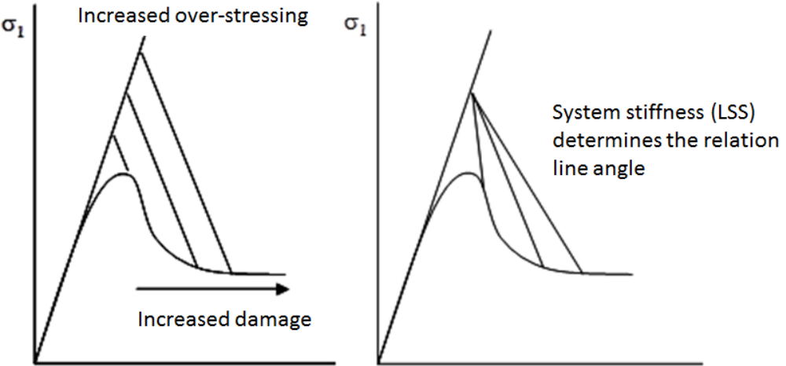
Barsanti & Basson, 2015 (Map3D Training notes)
BasRock

Slide 21
02 · BEM MODELLING
Correlation, not calibration
CALIBRATION · impossible with BEM
A quantitative match to measured behaviour — out of reach for an elastic model.
CORRELATION · aim
A qualitative link: higher index → worse conditions. Enough to predict.
Method: rate conditions → read far-field stress → plot σ₁–σ₃ → pick the criterion that separates best → predict → check underground (Terzaghi loop).
RCF THRESHOLD BANDS — JAGER & RYDER, 1999
stable
< 0.7
moderate
0.7 – 1.0
severe
1.0 – 1.4
heavy · burst-prone
1.4 – 2.1
extreme
> 2.1
Tanami: RCF beat σ₁ at separating damage — and the site recalibrated its own bands: moderate < 0.75, high 0.75–0.85, very high > 0.85. The generic bands are a starting point, not gospel.
Barsanti & Basson, 2015 · Jager & Ryder, 1999
Notes:
12:30–13:00 (end of Section 2). Define the two words carefully. Calibration = quantitative reproduction of measured behaviour — impossible with elastic. Correlation = a dependable qualitative ranking, which is enough to predict, via the Terzaghi observe-predict-confirm loop. Show the Jager & Ryder bands, then the Tanami punchline: RCF out-performed σ₁ AND the site moved its own thresholds — generic bands are a starting point, local correlation is what you act on.

Slide 22
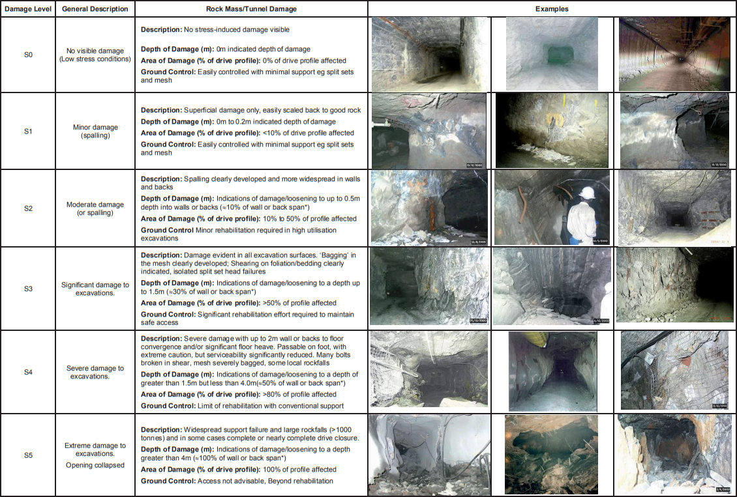

Slide 23
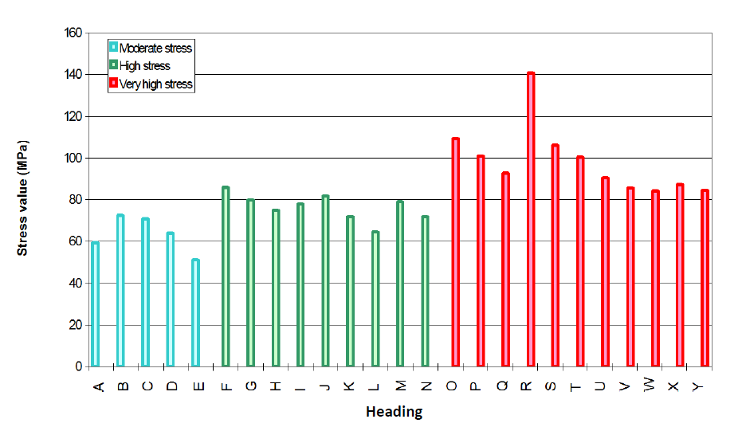
Barsanti & Basson, 2015
BasRock

Slide 24
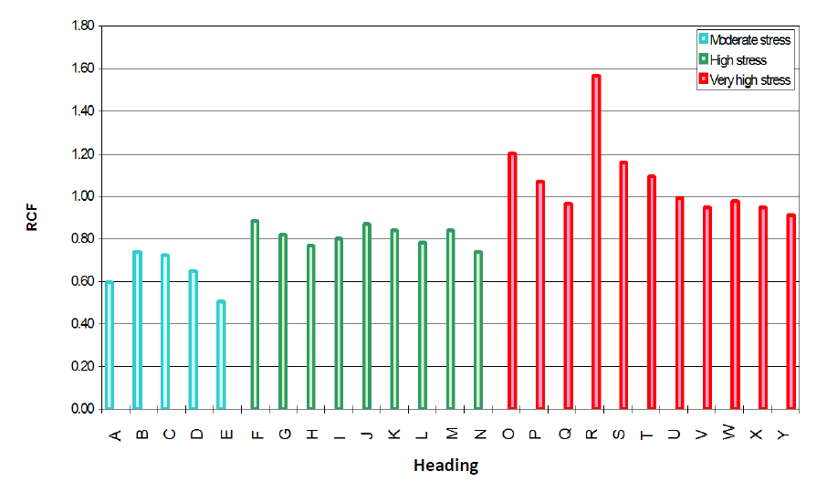
Barsanti & Basson, 2015
BasRock

Slide 25
SECTION 02
03
Demonstration: GEM4D BEM
10 minutes
Solve the boundary once.
Calculate the stress anywhere and anytime.
Notes:
9:00. Section 2 (4 min). What a boundary-element model is, what it is good for, what it cannot do, and why separating the surface solution from the results is the whole trick.

Slide 26

02 · BEM MODELLING
Solve once, then re-sample without re-solving
Boundary surfaces
solved once
the expensive step
Field points
sampled cheaply
grids · iso-surfaces · drive points · minodes
Re-sample and re-visualise without re-solving. Change the picture, not the model — this is the GEM4D BEM logic you’ll see next.
BasRock
Notes:
11:30–12:30. The key operational idea. The costly step is solving the boundary surfaces. Once that’s done, the field is essentially free to query — grids, iso-surfaces, points along the drive, minodes. So we change the visualisation without re-running the model. This is precisely what the GEM4D demo exploits.

Slide 27

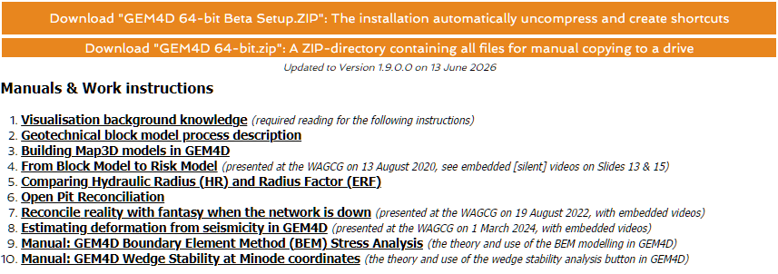
The demonstration will be fast paced
But a manual is available from
https://www.basrock.net/gem4d
Notes:
25:30–30:00. Bookend the title. Restate the refrain — same equation, new denominator each time. >>> ADD the GEM4D + BasRock.BEM download link in place of the placeholder chip. Then open the floor — roughly five minutes for questions.

Slide 28
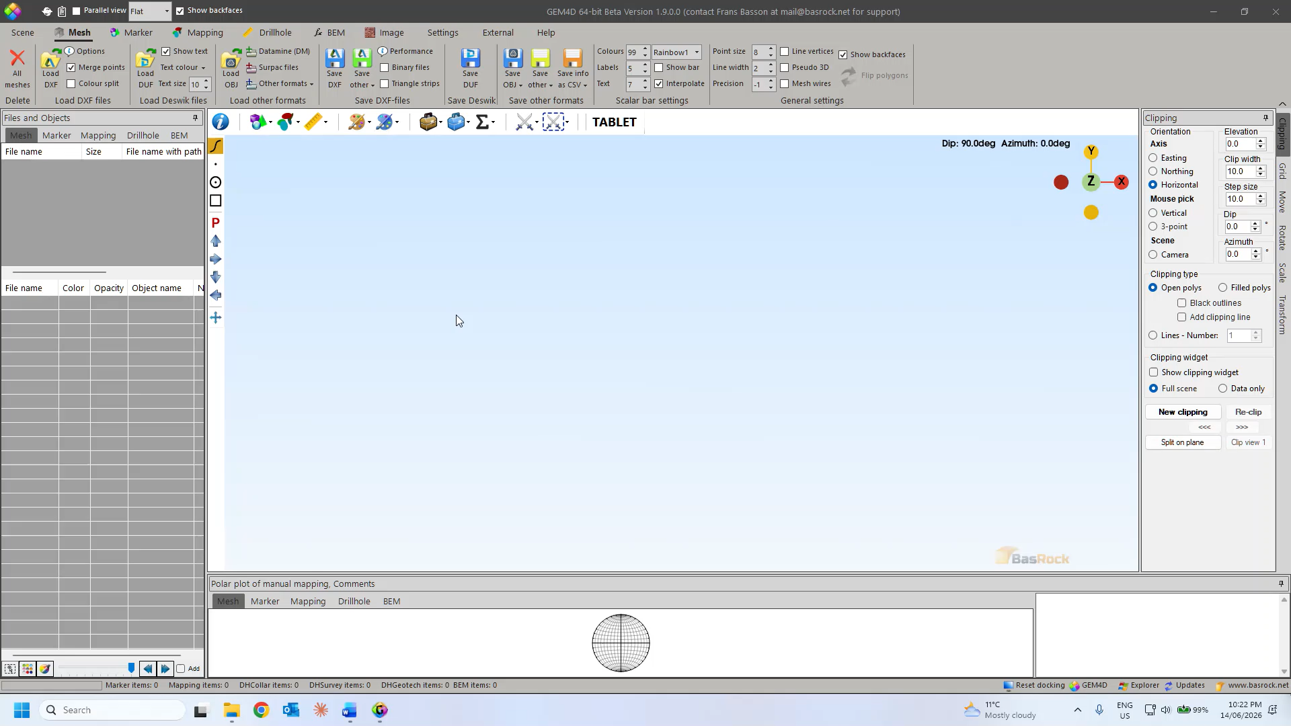

Slide 29
SECTION 02
04
Conclusions
3 minutes
Solve the boundary once.
Calculate the stress anywhere and anytime.
Notes:
9:00. Section 2 (4 min). What a boundary-element model is, what it is good for, what it cannot do, and why separating the surface solution from the results is the whole trick.

Slide 30

THE ANSWER
Pretty pictures or better decisions?
Same numerator, new denominator.
Kirsch’s 3σ₁ − σ₃ hasn’t changed in 125 years. Some criteria just divide it by something else — F, s, σCI.
Right criterion for the right question.
RCF for planning (far-field); Di and depth-of-failure for support (near-field). Don’t conflate them.
Correlation, not calibration.
An elastic model earns trust only through back-analysis against what the drive actually does.
The picture serves the decision.
A render that doesn’t change a decision or aid in understanding is just a picture.
Better decisions — but only when the picture is built on the right criterion, correlated with observation, and aimed at the real question.
du Plooy & Basson, 2012 · Barsanti & Basson, 2015 · Martin, Kaiser & McCreath, 1999
BasRock
Notes:
23:30–25:30. The payoff — four points. (1) Same numerator, new denominator — Kirsch’s 3σ₁−σ₃ is unchanged; criteria only change the divisor. (2) Match criterion to question — RCF for far-field planning, Di / depth-of-failure for near-field support; never conflate. (3) Correlation not calibration — trust comes from back-analysis underground. (4) The picture must serve the decision and the audience: a render that changes no decision is just a picture. Land the closing line.

Slide 31
Notes:
25:30–30:00. Bookend the title. Restate the refrain — same equation, new denominator each time. >>> ADD the GEM4D + BasRock.BEM download link in place of the placeholder chip. Then open the floor — roughly five minutes for questions.

Slide 32
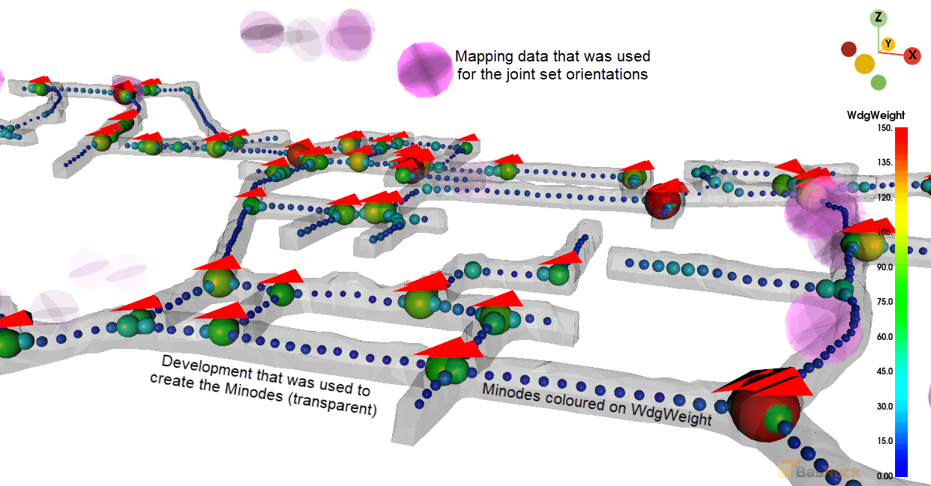
Thank you · Questions
Frans Basson · BasRock
Notes:
25:30–30:00. Bookend the title. Restate the refrain — same equation, new denominator each time. >>> ADD the GEM4D + BasRock.BEM download link in place of the placeholder chip. Then open the floor — roughly five minutes for questions.

